Slide 1

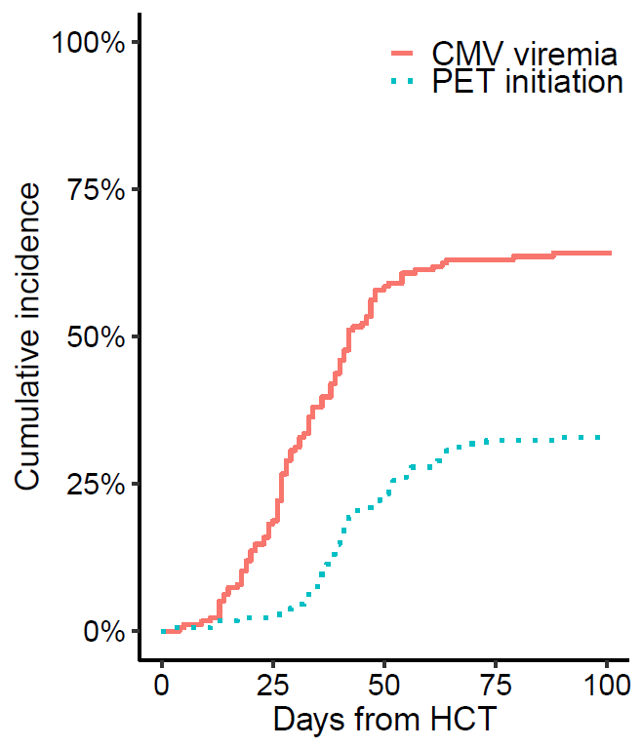
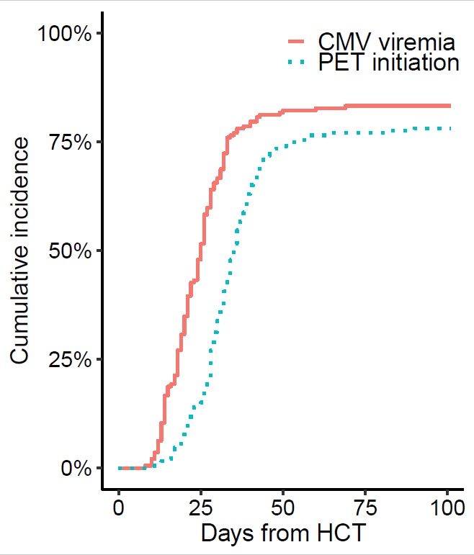
CMV Outcomes and Health Care Resource Utilization in CMV-seropositive (R+) Hematopoietic Stem Cell Transplant (HCT) Recipients Managed with Pre-emptive Therapy (PET)
Jiaqi Fang¹, M.D., M.P.H., Phaedon D. Zavras¹, M.D., Yiqi Su¹, M.S., Amit D. Raval², Ph.D., Yuexin Tang², Ph.D., Miguel-Angel Perales^{3,4}, M.D., Sergio Giralt^{3,4}, M.D., Genovefa Papanicolaou^{1,4}, M.D.
¹Memorial Sloan Kettering Cancer Center, Infectious Disease Service, New York, NY, United States, ²Merck & Co., Inc., Kenilworth, NJ, United States, ³Memorial Sloan Kettering Cancer Center, Bone Marrow Transplant Service, New York, NY, United States, ⁴Weill Cornell Medical College, Cornell University, New York, NY, United States
INTRODUCTION
METHODS
CMV viremia occurs in 40% - 90% of CMV R+ recipients and is associated with increased overall mortality after hematopoietic cell transplantation (HCT) ¹.
Risk factors for CMV reactivation after HCT include T-cell depletion, allograft from HLA-mismatched and graft-versus-host disease (GvHD) ¹.
Pre-emptive therapy (PET) has reduced the risk of CMV end-organ disease (EOD) ² and associated mortality; However, it may lead to substantial antiviral use along with its toxicities and higher healthcare resource utilization. Limited real-world data exists about CMV outcomes and healthcare resource utilization with PET.
Established benchmarks of CMV outcomes and HCRU in the era of PET are required to perform cost benefit analyses of novel interventions for CMV.
Study Design: Retrospective cohort study
Study Population: CMV R+ adult recipients of first peripheral blood or marrow allograft at MSKCC from March 2013 to December 2017.
CMV monitoring: CMV+ recipients were monitored weekly by quantitative PCR assay starting on day 14 through day 180 post HCT and treated pre-emptively. CMV EOD was scored by the standard criteria. CMV resistance mutations were confirmed by sequencing (Viracor-Eurofins).
The follow-up period was until day 180 post-HCT or death, whichever occurred first.
PET group: Receipt of pre-emptive antiviral therapy for CMV viremia.
CMV RISK: High CMV risk (HR) comprised recipients of conventional HCT from mismatched or haploidentical donors or recipients of T-cell depleted (TCD) HCT regardless of donor HLA match. Low CMV risk (LR) included conventional HCT from matched related donors.
Healthcare resource utilization was measured as length of stay (LOS) for incident admission, readmission rate per 1000 patient-day and number of patients required readmission by day 180 post HCT.
Risk-Stratified analyses were performed to examine outcomes by PET use and CMV risk.
OBJECTIVES
To report rates of CMV end-organ disease (EOD), CMV antiviral resistance, CMV-related mortality and rates of readmission and hospital length of stay (LOS) by day+180 in a contemporary cohort of HCT recipients in major Cancer Center in New York City.
RESULTS
Among 368 CMV R+ recipients included in this study, over half of the recipients were male with an average age of 55.9 years.
High risk patients had higher incidence, earlier onset of CMV viremia and earlier initiation of PET compared with low risk patients.
CMV outcomes (End organ disease, antiviral resistance) at day+180 among PET group
Clinical Characteristics | Overall N=368 | %
Underlying Disease
Leukemia | 186 | 51%
Lymphoma | 51 | 14%
Other | 131 | 36%
HLA match
Matched related donor | 117 | 32%
Matched unrelated donor | 192 | 52%
Mismatched (related or unrelated) | 59 | 16%
Stem cell source
Peripheral blood | 319 | 87%
Bone Marrow | 49 | 13%
Conditioning regimen
Myeloablative | 226 | 61%
Reduced intensity | 111 | 30%
Ex vivo T-cell depletion | 156 | 42%
CMV Risk
High | 192 | 52%
Low | 176 | 48%
83.3%
64.2%
78.1%
33.0%
Low Risk (n=176)
High Risk (n=192)
17 patients developed EOD (gastrointestinal disease in 12, retinitis in 1, pneumonitis and encephalitis in 2 patients each);
7 patients developed CMV resistance: (val)Ganciclovir 5 patients, Cidofovir 1 patient and Cidofovir+Foscarnet 1 patient.
Patients in PET group had longer inpatient stays for HCT admission than patients in NO PET group
A greater proportion of patients within the PET group required readmission
Overall, PET group had higher rates of readmission
CONCLUSION
4.5% of CMV R+ recipients developed CMV EOD by day+180. Two thirds of CMV EOD cases occurred in high risk group.
3% of patients that received PET (4% among high risk group) were identified to have CMV resistance mutations by day+180.
CMV related mortality was 1.5% among high risk group by day+180.
PET was associated with higher healthcare resource utilization (HCRU) including longer inpatient stays for HCT (p=0.0001), higher rates of readmission (p<0.001) and higher proportion of patients required readmission (p<0.001) by day+180.
Our real-world data highlights the need for improved management strategies for CMV in HCT recipients.
DISCLOSURE
The study was funded by a grant from Merck & Co., Inc
Green ML, Leisenring W, Xie H, et al. Cytomegalovirus viral load and mortality after haemopoietic stem cell transplantation in the era of pre-emptive therapy: a retrospective cohort study. Lancet Haematol. 2016;3: e119–e127.
de la Camara R. CMV in hematopoietic stem cell transplantation. Mediterr J Hematol Infect Dis. 2016;8 e2016031.

